Slide 1
PART IV
Network Layer

Slide 2
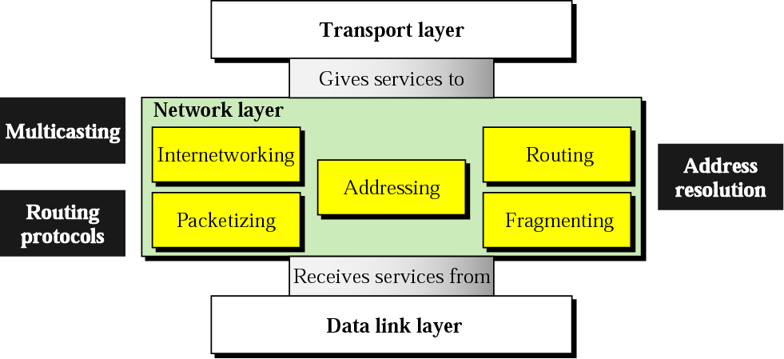
Position of network layer

Slide 3
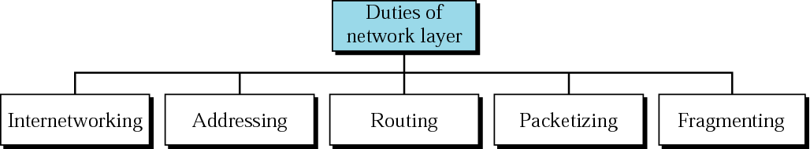
Network layer duties

Slide 4
Chapters
Chapter 19 Host-to-Host Delivery
Chapter 20 Network Layer Protocols
Chapter 21 Unicast and Multicast Routing Protocols

Slide 5
Chapter 19
Host-to-Host Delivery:
Internetworking, Addressing, and Routing

Slide 6
19.1 Internetworks
Need For Network Layer
Internet As A Packet-Switched Network
Internet As A Connectionless Network

Slide 7
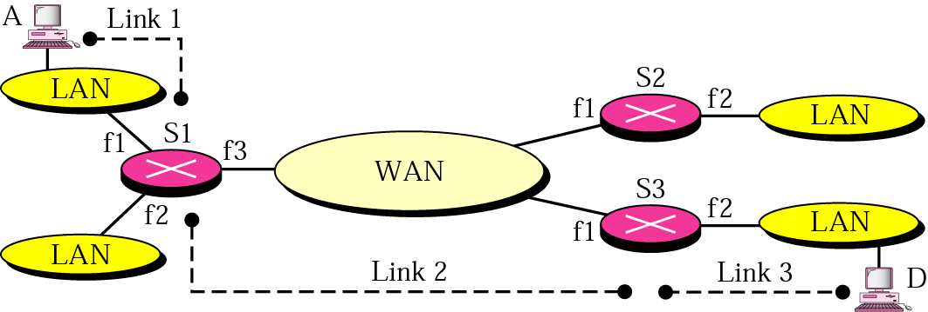
Figure 19.1 Internetwork

Slide 8
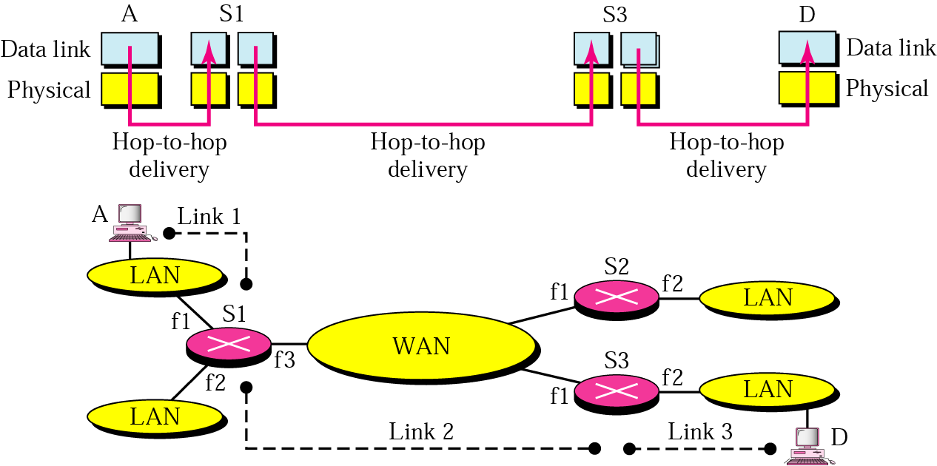
Figure 19.2 Links in an internetwork

Slide 9
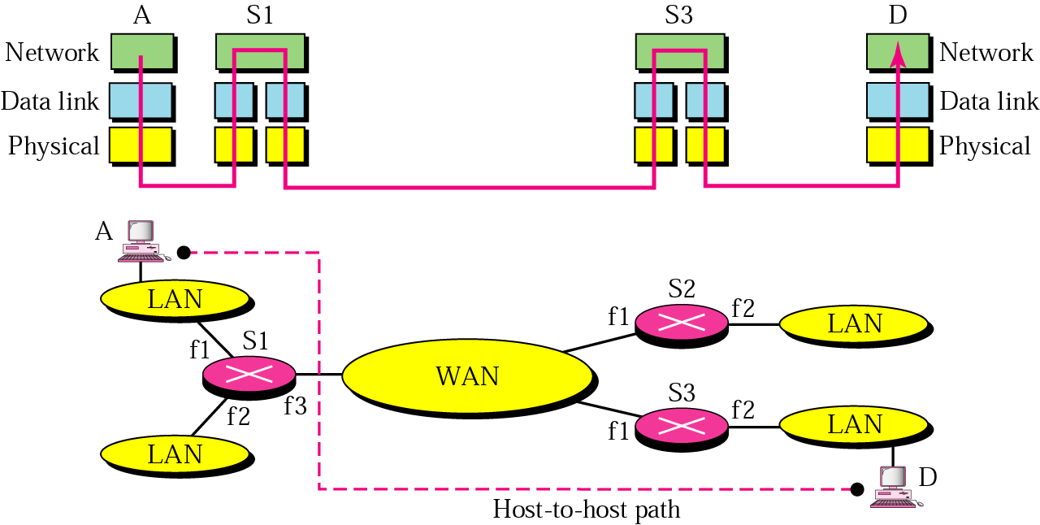
Figure 19.3 Network layer in an internetwork

Slide 10
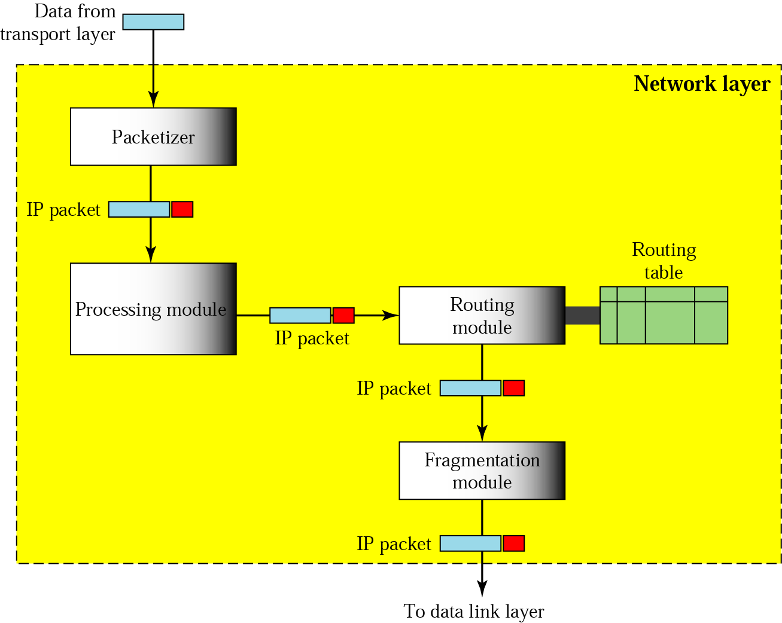
Figure 19.4 Network layer at the source

Slide 11
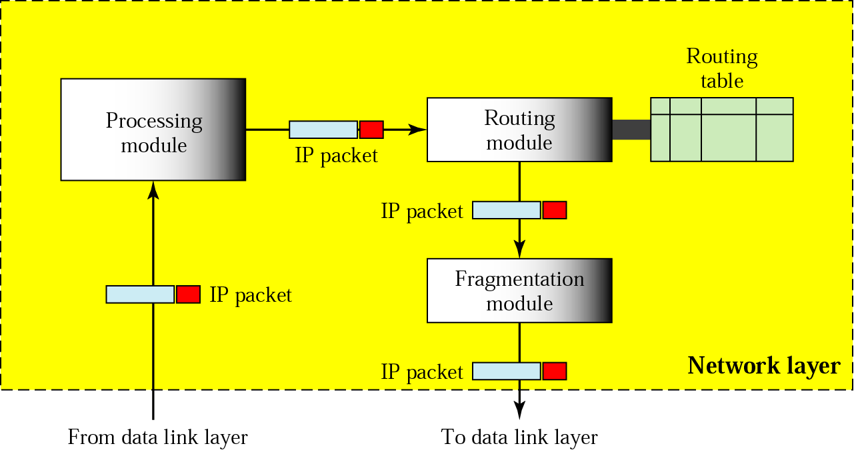
Figure 19.5 Network layer at a router

Slide 12
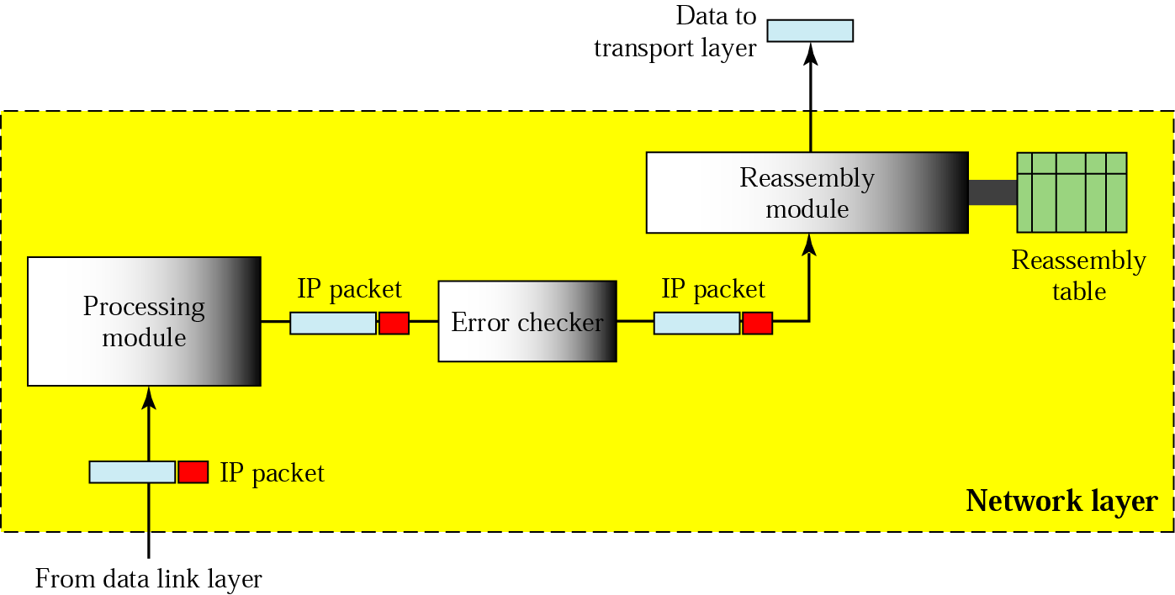
Figure 19.6 Network layer at the destination

Slide 13
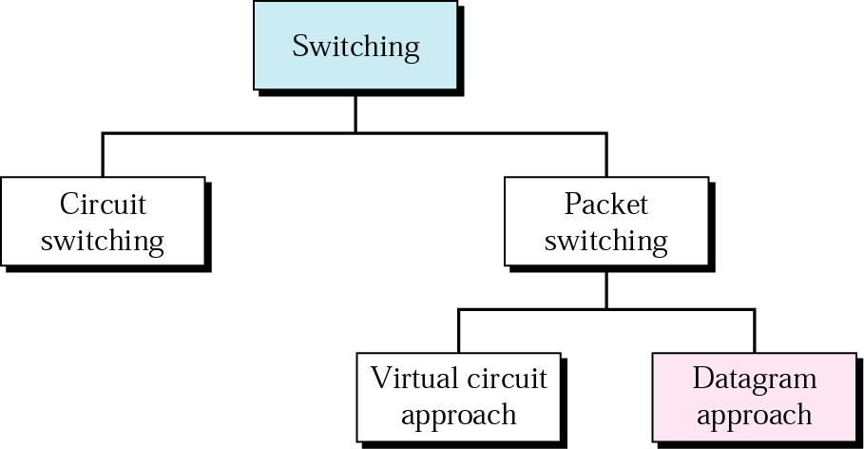
Figure 19.7 Switching

Slide 14
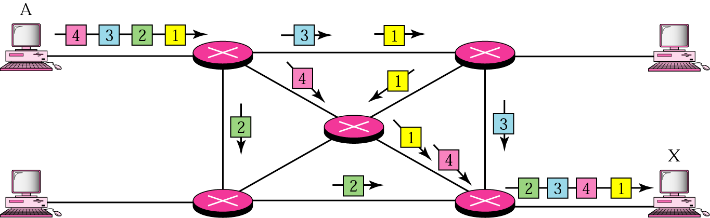
Figure 19.8 Datagram approach

Slide 15
Note:
Switching at the network layer in the Internet is done using the datagram approach to packet switching.

Slide 16
Note:
Communication at the network layer in the Internet is connectionless.

Slide 17
19.2 Addressing
Internet Address
Classful Addressing
Subnetting
Supernetting
Classless Addressing
Dynamic Address Configuration
Network Address Translation

Slide 18
Note:
An IP address is a 32-bit address.

Slide 19
Note:
The IP addresses are unique and universal.

Slide 20
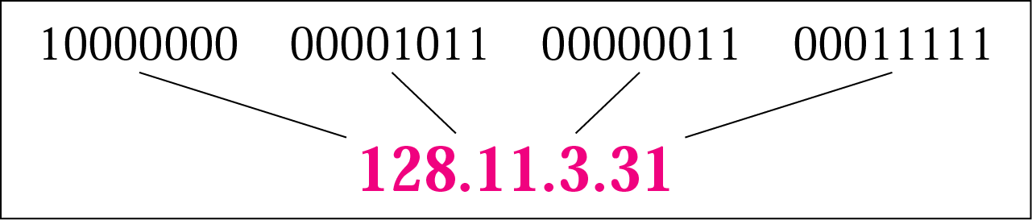
Figure 19.9 Dotted-decimal notation

Slide 21
Note:
The binary, decimal, and hexadecimal number systems are reviewed in Appendix B.

Slide 22
Example 1
Change the following IP addresses from binary notation to dotted-decimal notation.
a. 10000001 00001011 00001011 11101111
b. 11111001 10011011 11111011 00001111
Solution
We replace each group of 8 bits with its equivalent decimal number (see Appendix B) and add dots for separation:
a. 129.11.11.239
b. 249.155.251.15

Slide 23
Example 2
Change the following IP addresses from dotted-decimal notation to binary notation.
a. 111.56.45.78
b. 75.45.34.78
Solution
We replace each decimal number with its binary equivalent (see Appendix B):
a. 01101111 00111000 00101101 01001110
b. 01001011 00101101 00100010 01001110

Slide 24
Note:
In classful addressing, the address space is divided into five classes: A, B, C, D, and E.

Slide 25
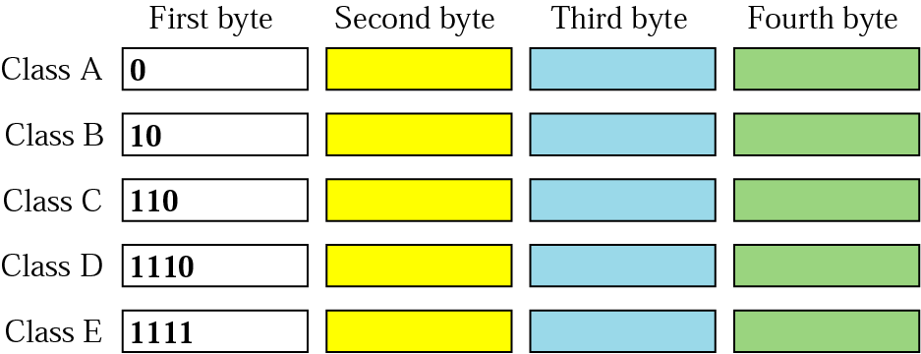
Figure 19.10 Finding the class in binary notation

Slide 26
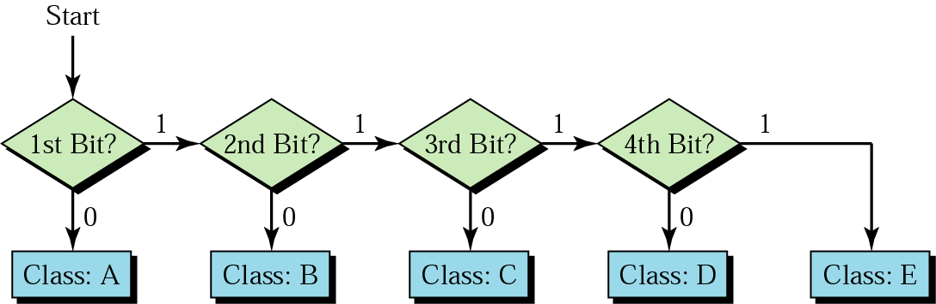
Figure 19.11 Finding the address class

Slide 27
Example 3
Find the class of each address:
a. 00000001 00001011 00001011 11101111
b. 11110011 10011011 11111011 00001111
Solution
See the procedure in Figure 19.11.
a. The first bit is 0; this is a class A address.
b. The first 4 bits are 1s; this is a class E address.

Slide 28
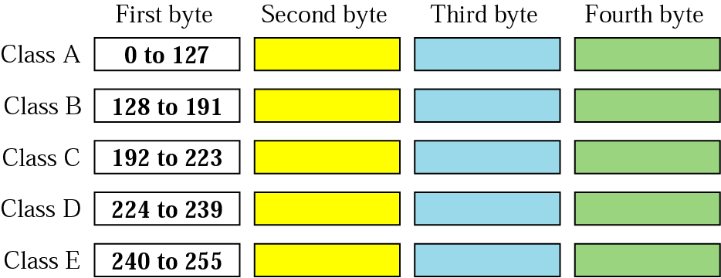
Figure 19.12 Finding the class in decimal notation

Slide 29
Example 4
Find the class of each address:
a. 227.12.14.87
b. 252.5.15.111
c. 134.11.78.56
Solution
a. The first byte is 227 (between 224 and 239); the class is D.
b. The first byte is 252 (between 240 and 255); the class is E.
c. The first byte is 134 (between 128 and 191); the class is B.

Slide 30
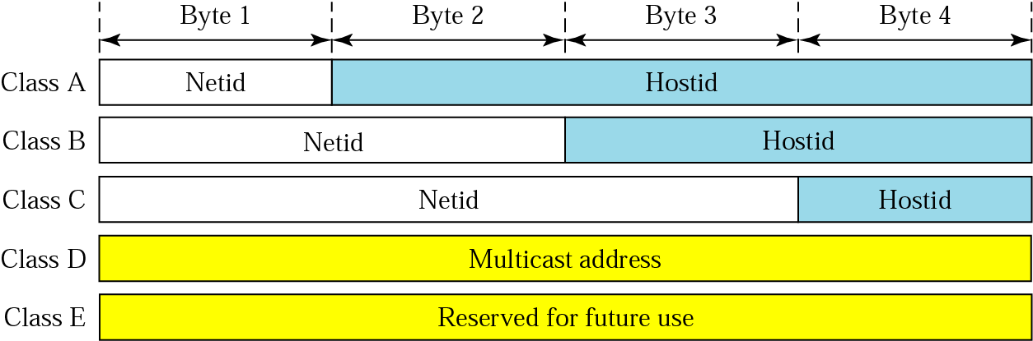
Figure 19.13 Netid and hostid

Slide 31
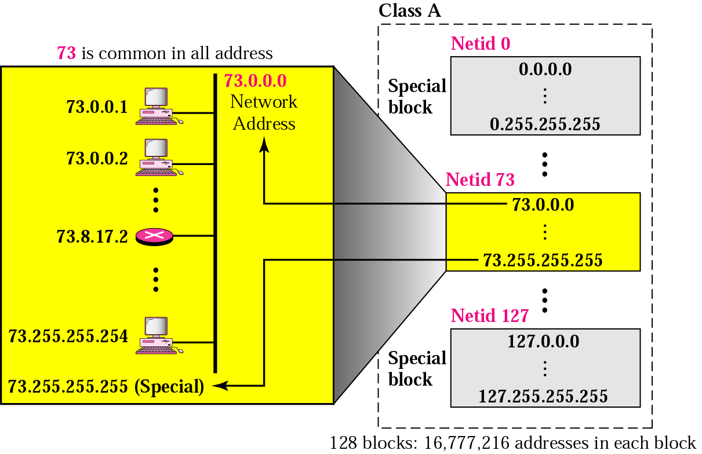
Figure 19.14 Blocks in class A

Slide 32
Note:
Millions of class A addresses are wasted.

Slide 33
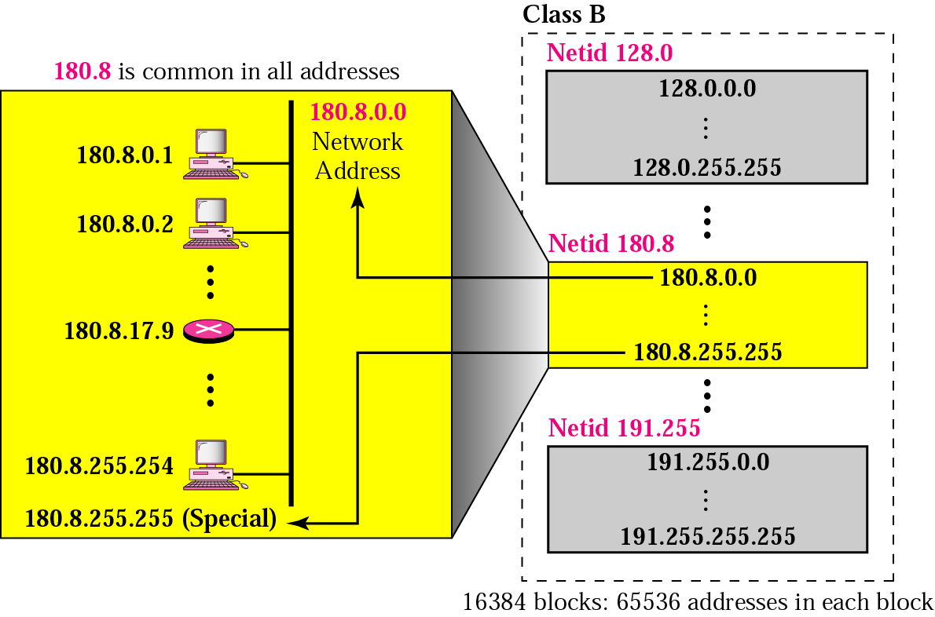
Figure 19.15 Blocks in class B

Slide 34
Note:
Many class B addresses are wasted.

Slide 35
Note:
The number of addresses in class C is smaller than the needs of most organizations.

Slide 36
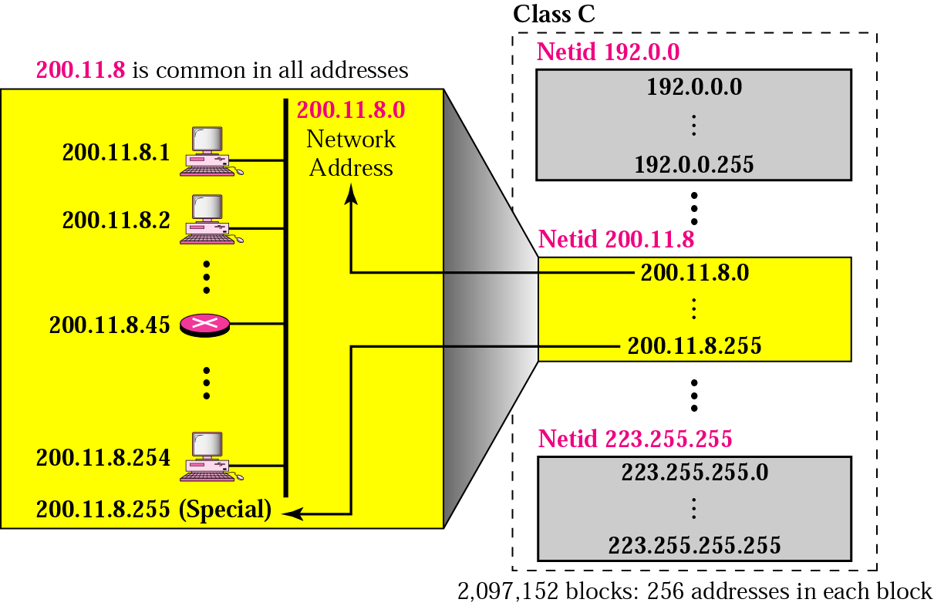
Figure 19.16 Blocks in class C

Slide 37
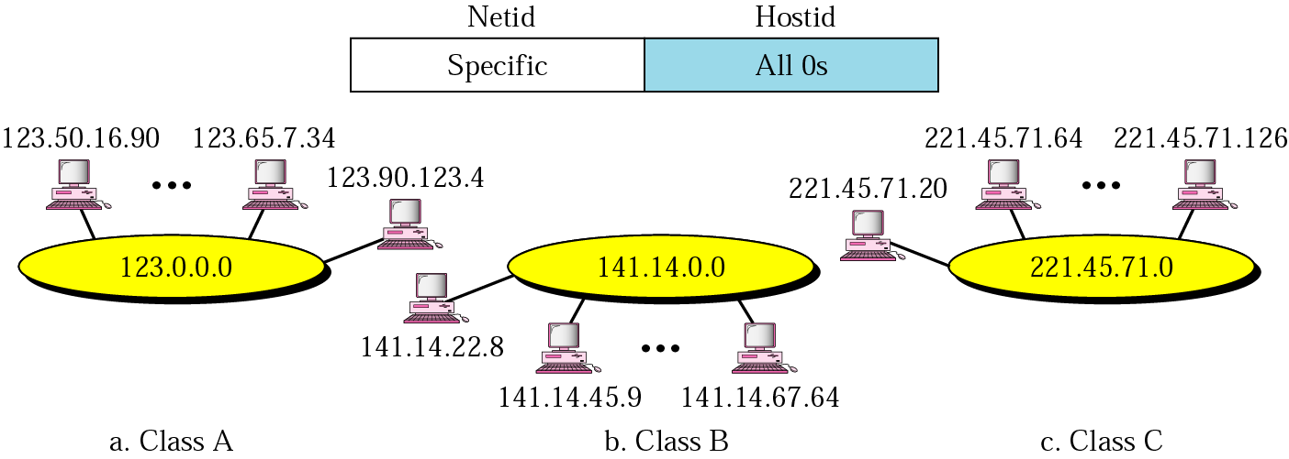
Figure 19.17 Network address

Slide 38
Note:
In classful addressing, the network address is the one that is assigned to the organization.

Slide 39
Example 5
Given the address 23.56.7.91, find the network address.
Solution
The class is A. Only the first byte defines the netid. We can find the network address by replacing the hostid bytes (56.7.91) with 0s. Therefore, the network address is 23.0.0.0.

Slide 40
Example 6
Given the address 132.6.17.85, find the network address.
Solution
The class is B. The first 2 bytes defines the netid. We can find the network address by replacing the hostid bytes (17.85) with 0s. Therefore, the network address is 132.6.0.0.

Slide 41
Example 7
Given the network address 17.0.0.0, find the class.
Solution
The class is A because the netid is only 1 byte.

Slide 42
Note:
A network address is different from a netid. A network address has both netid and hostid, with 0s for the hostid.

Slide 43
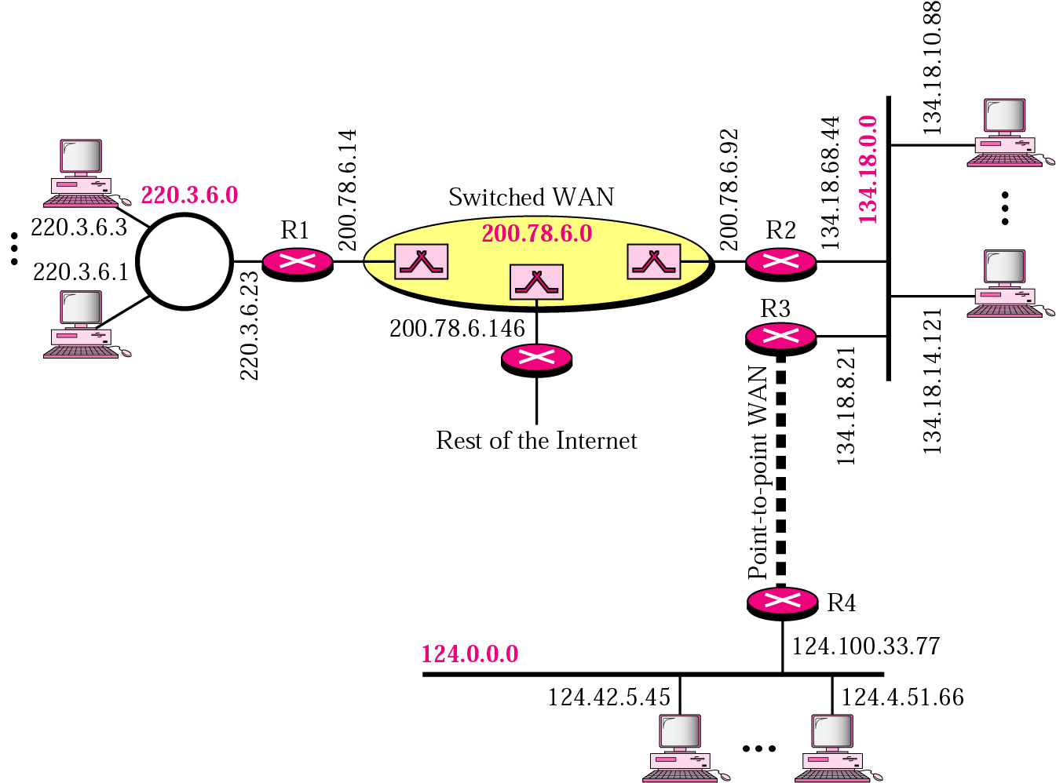
Figure 19.18 Sample internet

Slide 44
Note:
IP addresses are designed with two levels of hierarchy.

Slide 45
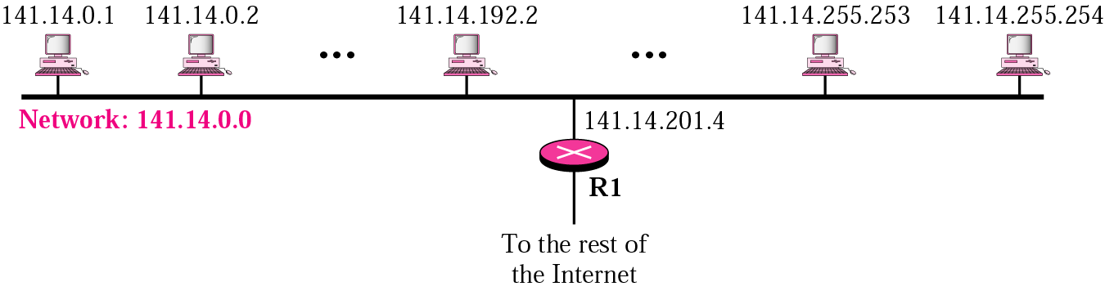
Figure 19.19 A network with two levels of hierarchy

Slide 46
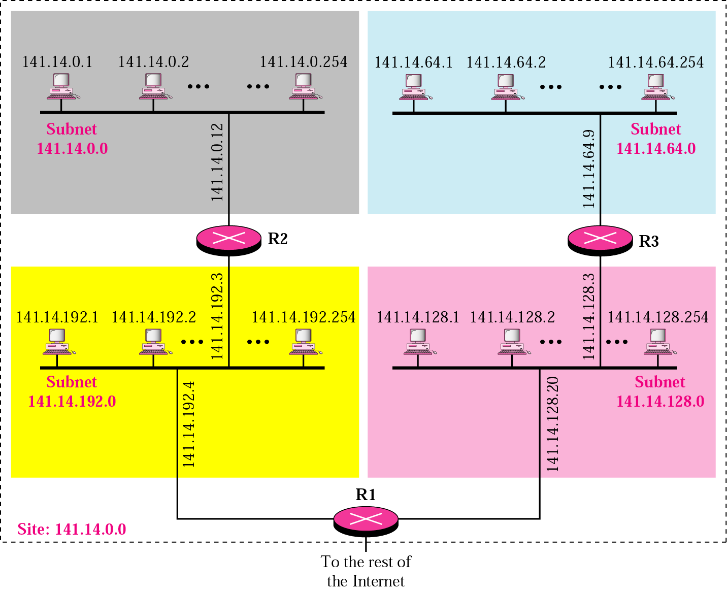
Figure 19.20 A network with three levels of hierarchy (subnetted)

Slide 47
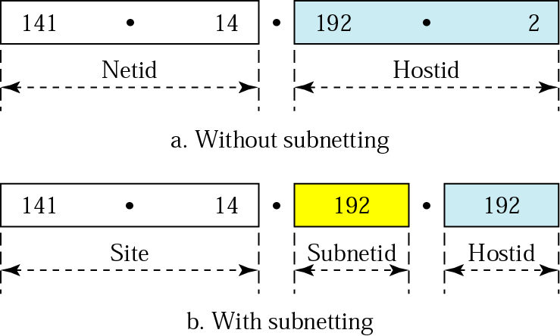
Figure 19.21 Addresses in a network with and without subnetting

Slide 48
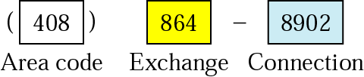
Figure 19.22 Hierarchy concept in a telephone number

Slide 49
Table 19.1 Default masks
Class | In Binary | In Dotted-Decimal | Using Slash
A | 11111111 00000000 00000000 00000000 | 255.0.0.0 | /8
B | 11111111 11111111 00000000 00000000 | 255.255.0.0 | /16
C | 11111111 111111111 11111111 00000000 | 255.255.255.0 | /24

Slide 50
Note:
The network address can be found by applying the default mask to any address in the block (including itself). It retains the netid of the block and sets the hostid to 0s.

Slide 51
Example 8
A router outside the organization receives a packet with destination address 190.240.7.91. Show how it finds the network address to route the packet.
Solution
The router follows three steps:
The router looks at the first byte of the address to find the class. It is class B.
The default mask for class B is 255.255.0.0. The router ANDs this mask with the address to get 190.240.0.0.
The router looks in its routing table to find out how to route the packet to this destination. Later, we will see what happens if this destination does not exist.

Slide 52
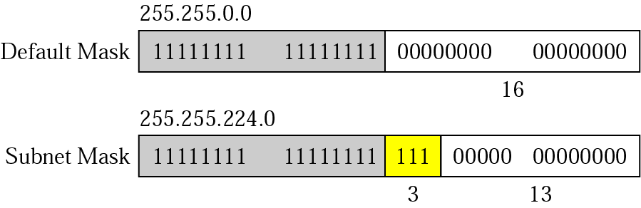
Figure 19.23 Subnet mask

Slide 53
Example 9
A router inside the organization receives the same packet with destination address 190.240.33.91. Show how it finds the subnetwork address to route the packet.
Solution
The router follows three steps:
The router must know the mask. We assume it is /19, as shown in Figure 19.23.
The router applies the mask to the address, 190.240.33.91. The subnet address is 190.240.32.0.
The router looks in its routing table to find how to route the packet to this destination. Later, we will see what happens if this destination does not exist.

Slide 54
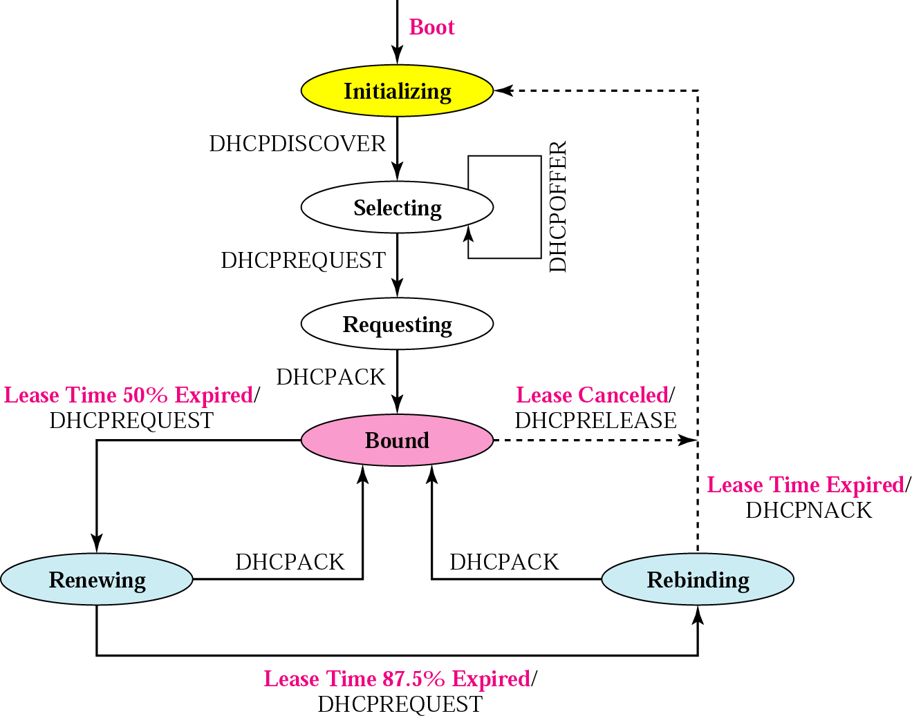
Figure 19.24 DHCP transition diagram

Slide 55
Table 19.2 Default masks
Range | Total
10.0.0.0 to 10.255.255.255 | 2²⁴
172.16.0.0 to 172.31.255.255 | 2²⁰
192.168.0.0 to 192.168.255.255 | 2¹⁶

Slide 56
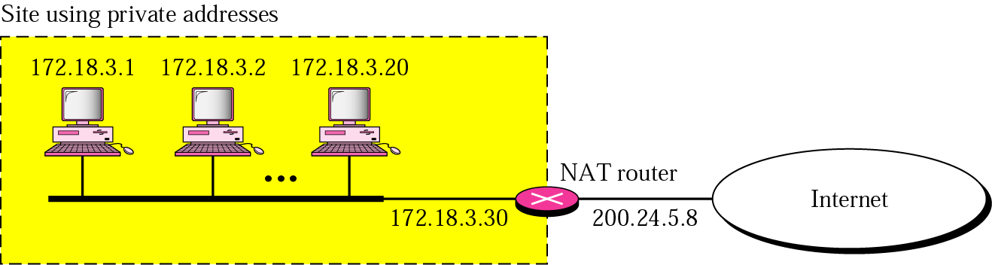
Figure 19.25 NAT

Slide 57
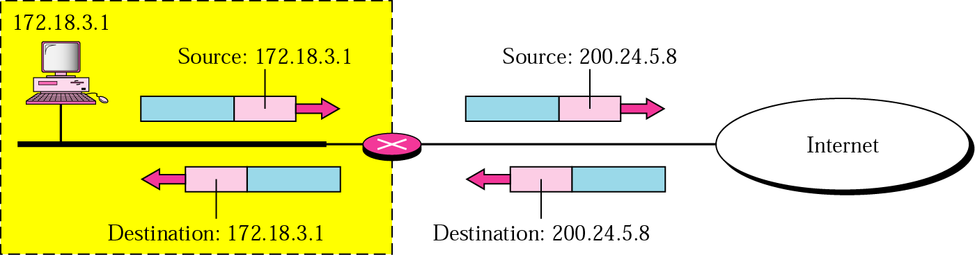
Figure 19.26 Address translation

Slide 58
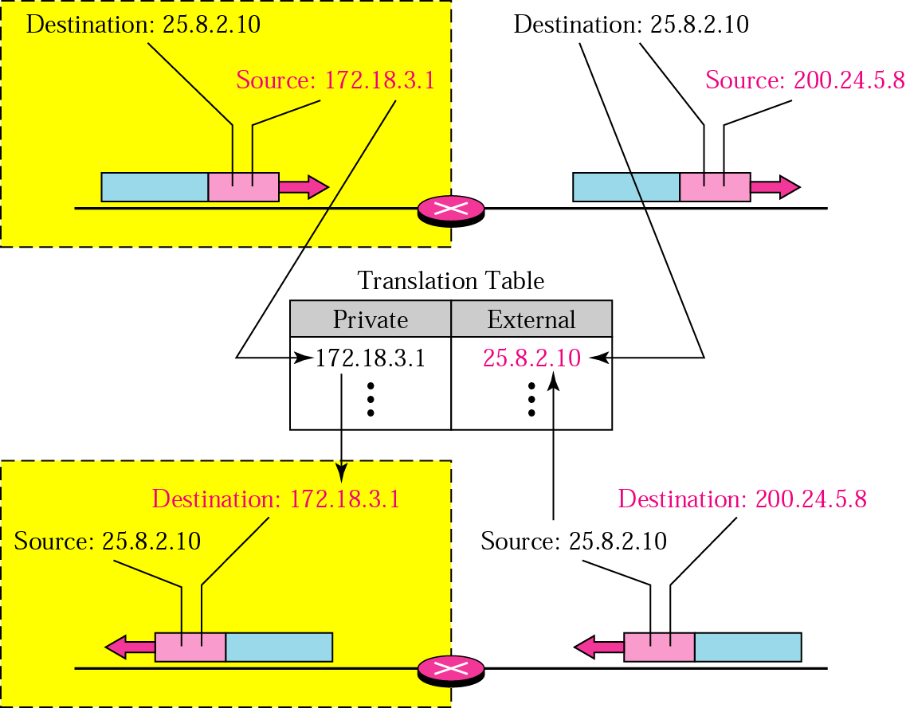
Figure 19.27 Translation

Slide 59
Table 19.3 Five-column translation table
Private Address | Private Port | External Address | External Port | Transport Protocol
172.18.3.1 | 1400 | 25.8.3.2 | 80 | TCP
172.18.3.2 | 1401 | 25.8.3.2 | 80 | TCP
... | ... | ... | ... | ...

Slide 60
19.3 Routing
Routing Techniques
Static Versus Dynamic Routing
Routing Table for Classful Addressing
Routing Table for Classless Addressing

Slide 61
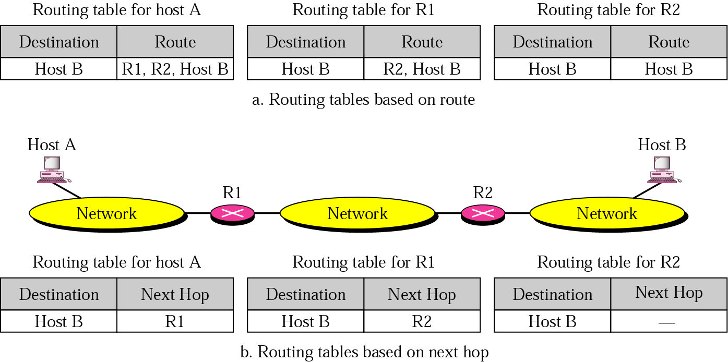
Figure 19.28 Next-hop routing

Slide 62
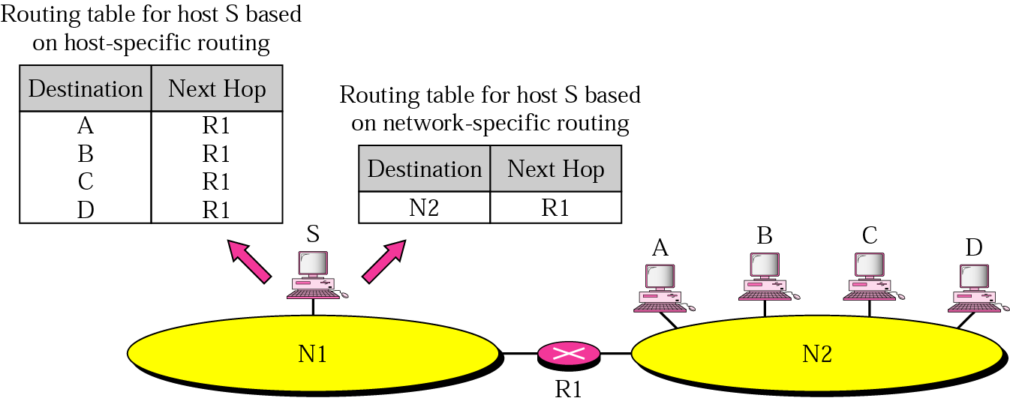
Figure 19.29 Network-specific routing

Slide 63
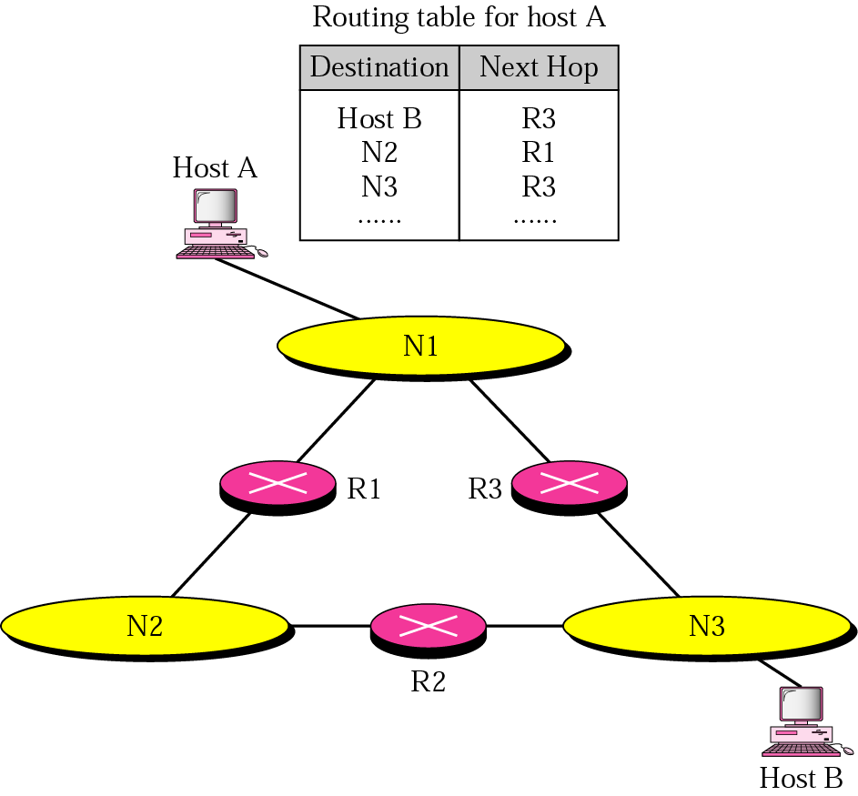
Figure 19.30 Host-specific routing

Slide 64
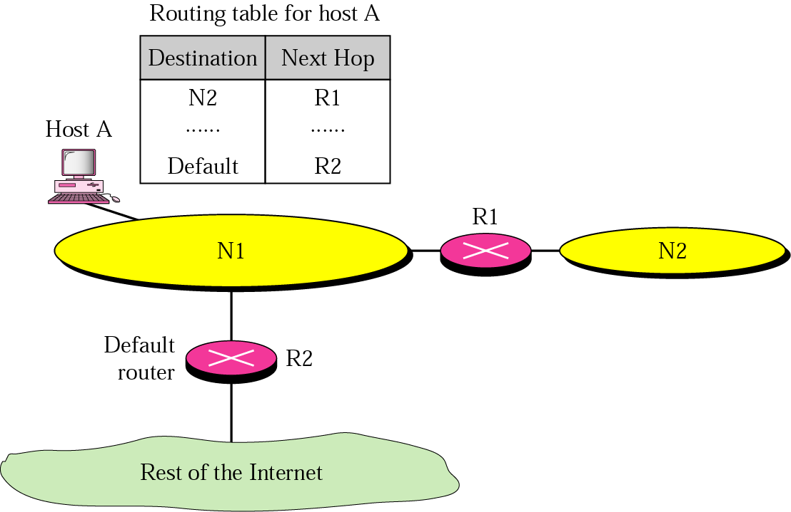
Figure 19.31 Default routing

Slide 65
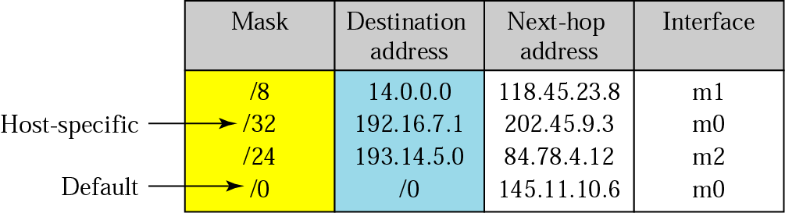
Figure 19.32 Classful addressing routing table

Slide 66
Example 10
Using the table in Figure 19.32, the router receives a packet for destination 192.16.7.1. For each row, the mask is applied to the destination address until a match with the destination address is found. In this example, the router sends the packet through interface m0 (host specific).

Slide 67
Example 11
Using the table in Figure 19.32, the router receives a packet for destination 193.14.5.22. For each row, the mask is applied to the destination address until a match with the next-hop address is found. In this example, the router sends the packet through interface m2 (network specific).

Slide 68
Example 12
Using the table in Figure 19.32, the router receives a packet for destination 200.34.12.34. For each row, the mask is applied to the destination address, but no match is found. In this example, the router sends the packet through the default interface m0.

